Slide 1
The Limits to Growth: Sustainability and the Circular Economy
Lecture 2: Challenges I: Natural Resources and Environmental Pollution
Prof. Dr. Benjamin Leiding
M.Sc. Anant Sujatanagarjuna
M.Sc. Nelly Nicaise Nyeck Mbialeu

Slide 2
License
This work is licensed under a Creative Commons Attribution-ShareAlike 4.0 International License. To view a copy of this license, please refer to https://creativecommons.org/licenses/by-sa/4.0/ .
Updated versions of these slides will be available in our Github repository.

Slide 3
Sustainability

Slide 4
Introduction
Sustainability
„Development that meets the needs of the present without compromising the ability of future generations to meet their own needs.”
Report of the World Commission on Environment and Development: Our Common Future (1987) – http://www.un-documents.net/our-common-future.pdf

Slide 5
Introduction
Sustainability – Origins
„Wie eine sothane [solche] Conservation und Anbau des Holzes anzustellen / daß es eine continuirliche beständige und nachhaltende Nutzung gebe / weiln es eine unentbehrliche Sache ist / ohne welche das Land in seinem Esse nicht bleiben mag” – Hans Carl von Carlowitz (1713)
Hans Carl von Carlowitz (1713) – Sylvicultura oeconomica

Slide 6
Introduction
Sustainability – Origins
„Wie eine sothane [solche] Conservation und Anbau des Holzes anzustellen / daß es eine continuirliche beständige und nachhaltende Nutzung gebe / weiln es eine unentbehrliche Sache ist / ohne welche das Land in seinem Esse nicht bleiben mag” – Hans Carl von Carlowitz (1713)
→ “continuously enduring and sustainable use”
Hans Carl von Carlowitz (1713) – Sylvicultura oeconomica

Slide 7
Introduction
Sustainability – Origins
„Sowing and planting of trees had to be regarded as a national duty of every landowner, in order to stop the destructive over-exploitation of natural resources” – John Evelyn (1662)
John Evelyn (1662) – Essay: „Sylva“

Slide 8
Introduction
Sustainability – Origins
Carl von Carlowitz and Sustainability
Coined the term at a time when Europe was in need of vast quantities of wood (mining, ore-smelting, ship building, etc.
→ Fear of timber scarcity
Growing population → Fear of food-shortage if food production cannot keep up with reproduction
World population in 1700 → ca. 0.6 billion people
World population in 1800 → ca. 1.0 billion people
Industrial revolution (ca. 1760 – 1840) fostered environmental degradation → society chose prosperity rather than sustainability

Slide 9
Biocapacity
Definition
Is „the locally available carrying capacity of the ecosystem for generating resources and absorbing wastes”
D. Yue, J. Guo, C. Hui (2013) – Scale dependency of biocapacity and the fallacy of unsustainable development – https://doi.org/10.1016/j.jenvman.2013.04.022

Slide 10
Ecological Footprint
Definition
„The ecological footprint for a particular population is defined as the total area of
productive land and water ecosystems required to produce sufficient resources and assimilate wastes”
1.) W.E. Rees (1992) – Ecological footprint and appropriated carrying capacity: what urban economics leaves out. Environmental Urbanization.
2.) W.E. Rees, M. Wackernagel (1994) – Ecological footprints and appropriated carrying capacity: measuring the natural capital requirements of the human economy.
3.) D. Yue, J. Guo, C. Hui (2013) – Scale dependency of biocapacity and the fallacy of unsustainable development – https://doi.org/10.1016/j.jenvman.2013.04.022

Slide 11
Sustainability
Implications
Sustainability → Consume less

Slide 12
Sustainability
Implications
Sustainability → Consume less

Slide 13
A Lack of Resources

Slide 14
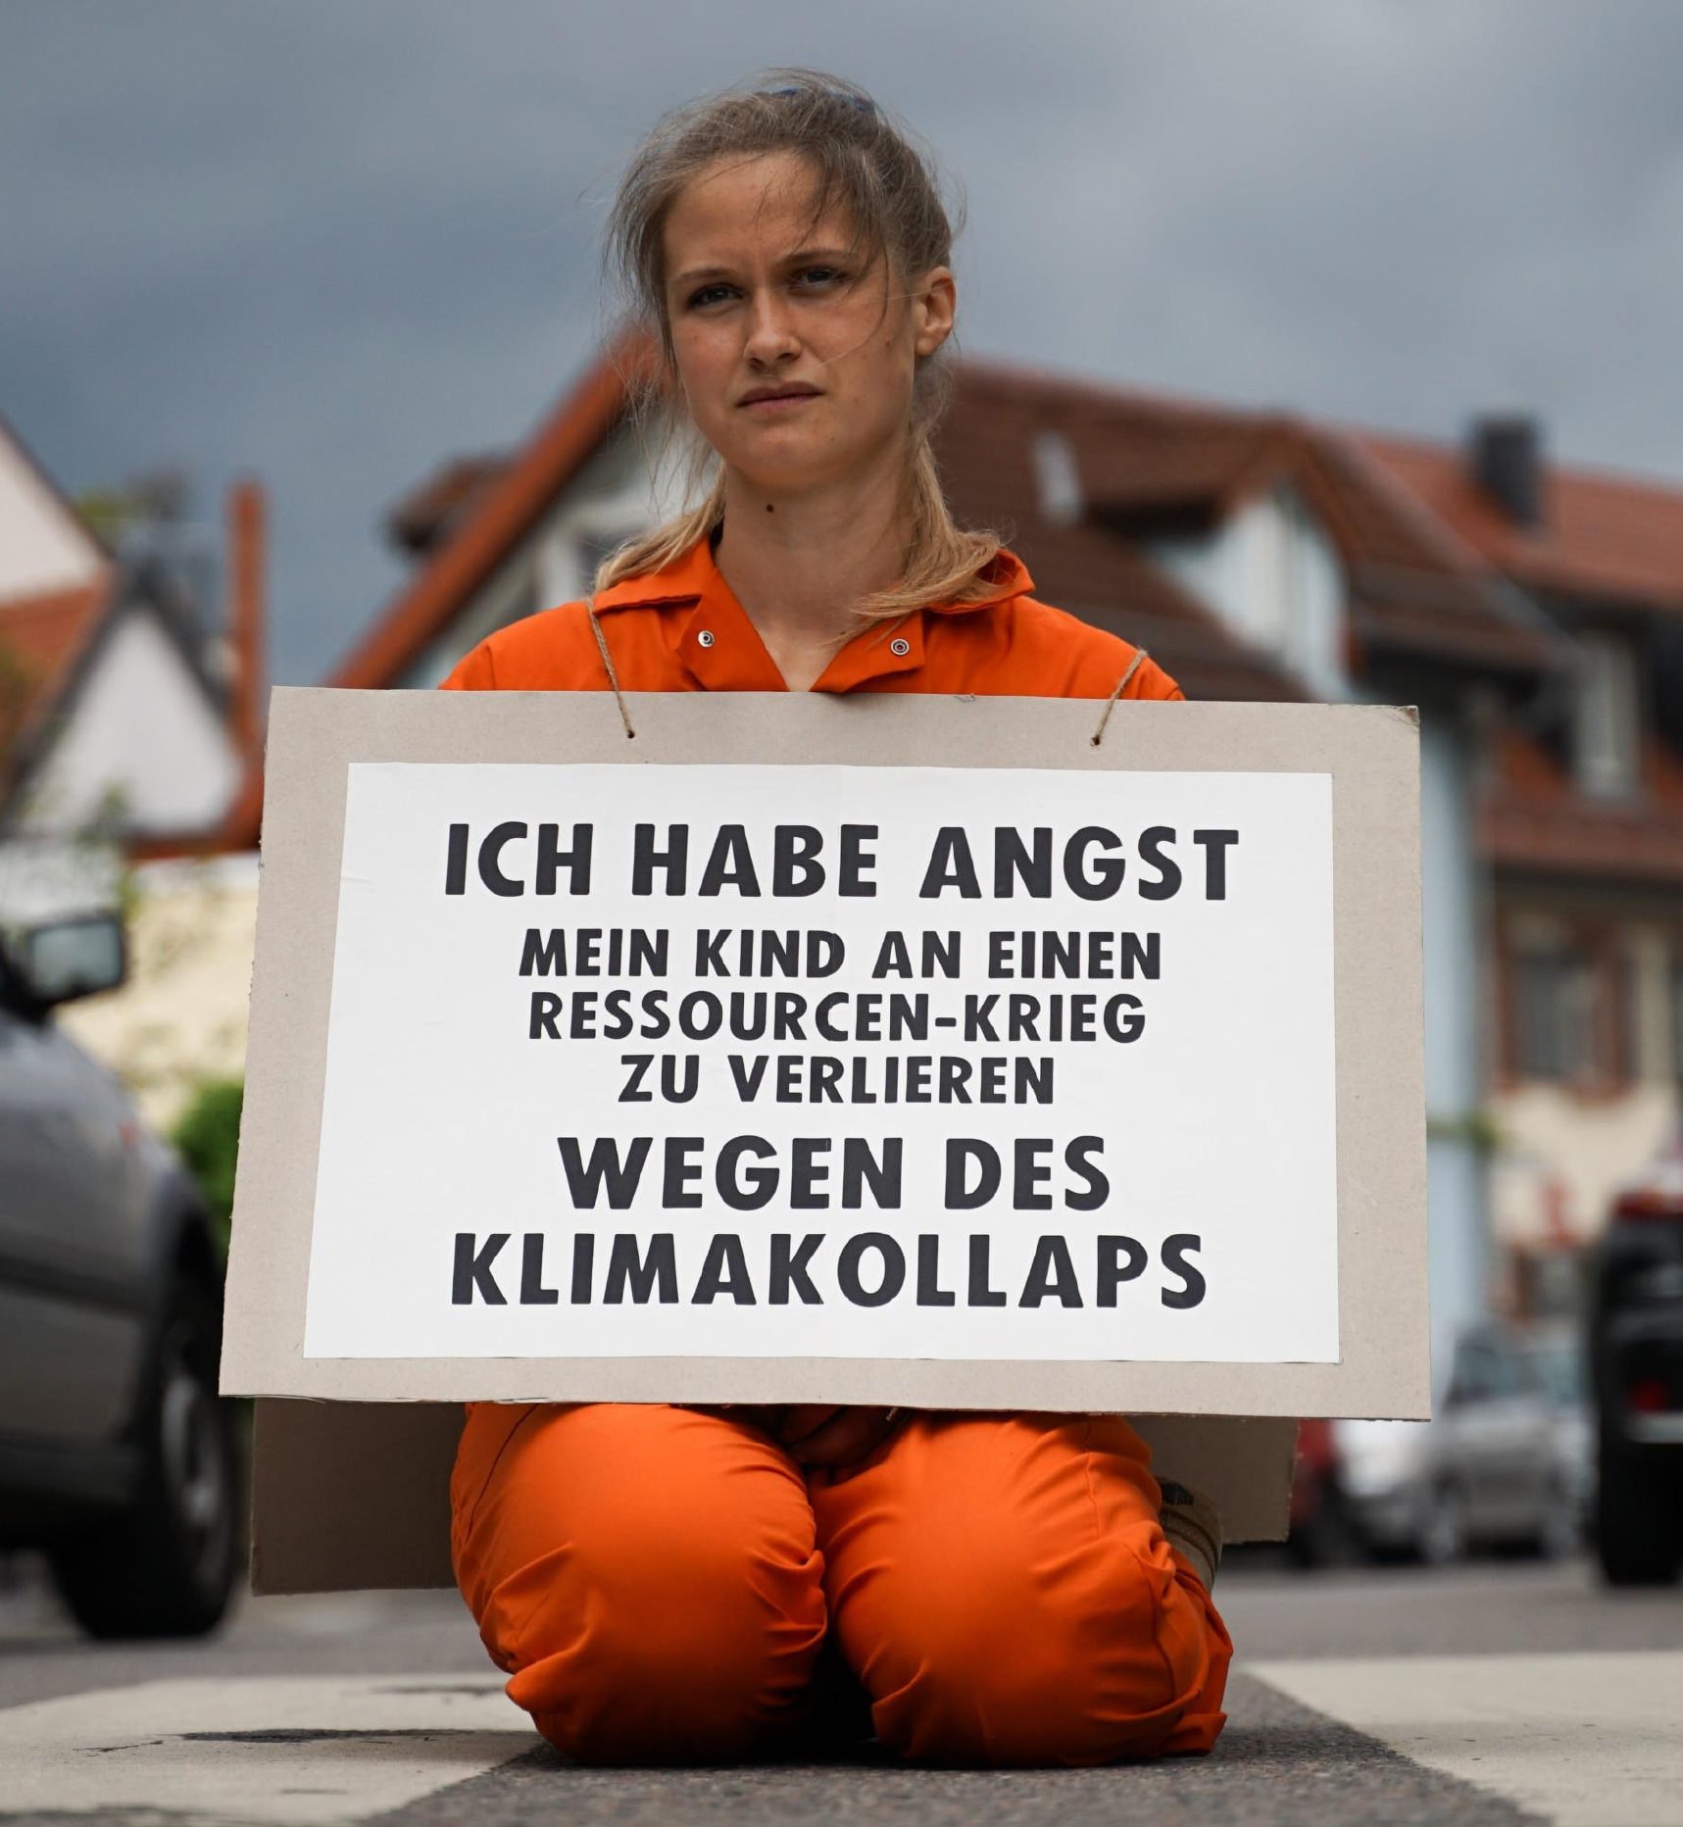
We only have one planet
Resources
“I am afraid of losing my child to a resource war because of a climate collapse”
→ “Our parents will die of old age, our children will die of climate change”
XR Strategiepapier 2022 – Pusteblumen und Hype. Bilder: Sebastian Höhn, Joe Pohl, Sandra Doneck, Alessandro Brönnimann

Slide 15
We only have one Planet
Resource Wars
“Resource wars are violent conflicts that are largely driven by competition for control over vital or valuable natural materials, such as oil, water, land, timber, animals (or animal products), gold, silver, gems, and other key minerals.”
Michael T. Klare, Barry S. Levy, Victor W. Sidel (2011) – The Public Health Implications of Resource Wars – Link.

Slide 16
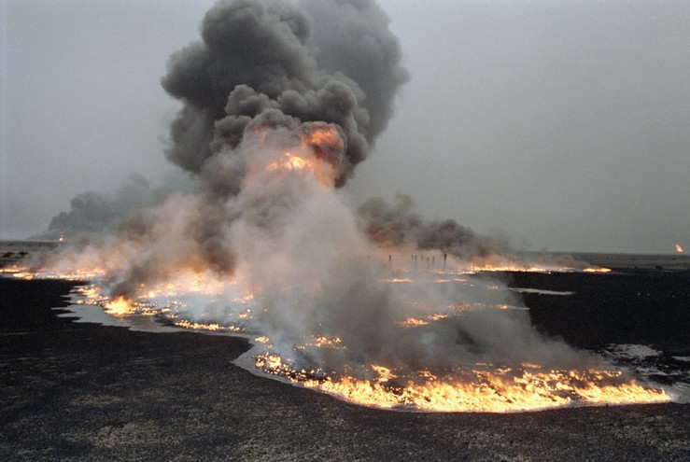
We only have one Planet
Resource Wars – Oil, etc.
United Nations Photo – https://www.flickr.com/photos/un_photo/5559102272 – CC BY-NC-ND 2.0.

Slide 17
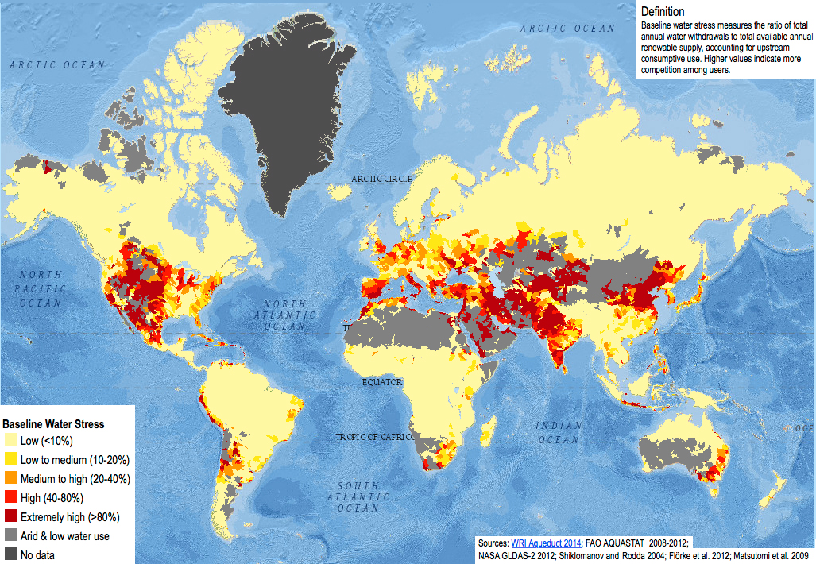
We only have one Planet
Resource Wars – Water
1. Sampa – https://commons.wikimedia.org/wiki/File:Baseline_water_stress.jpg – CC BY-SA 4.0.
2. Kgbo – https://commons.wikimedia.org/wiki/File:Closed_Wivenhoe_Dam_and_spillway,_August_2020.jpg – CC BY-SA 4.0.
3.Arian Zwegers – https://www.flickr.com/photos/azwegers/6226842732 – CC BY 2.0.

Slide 18
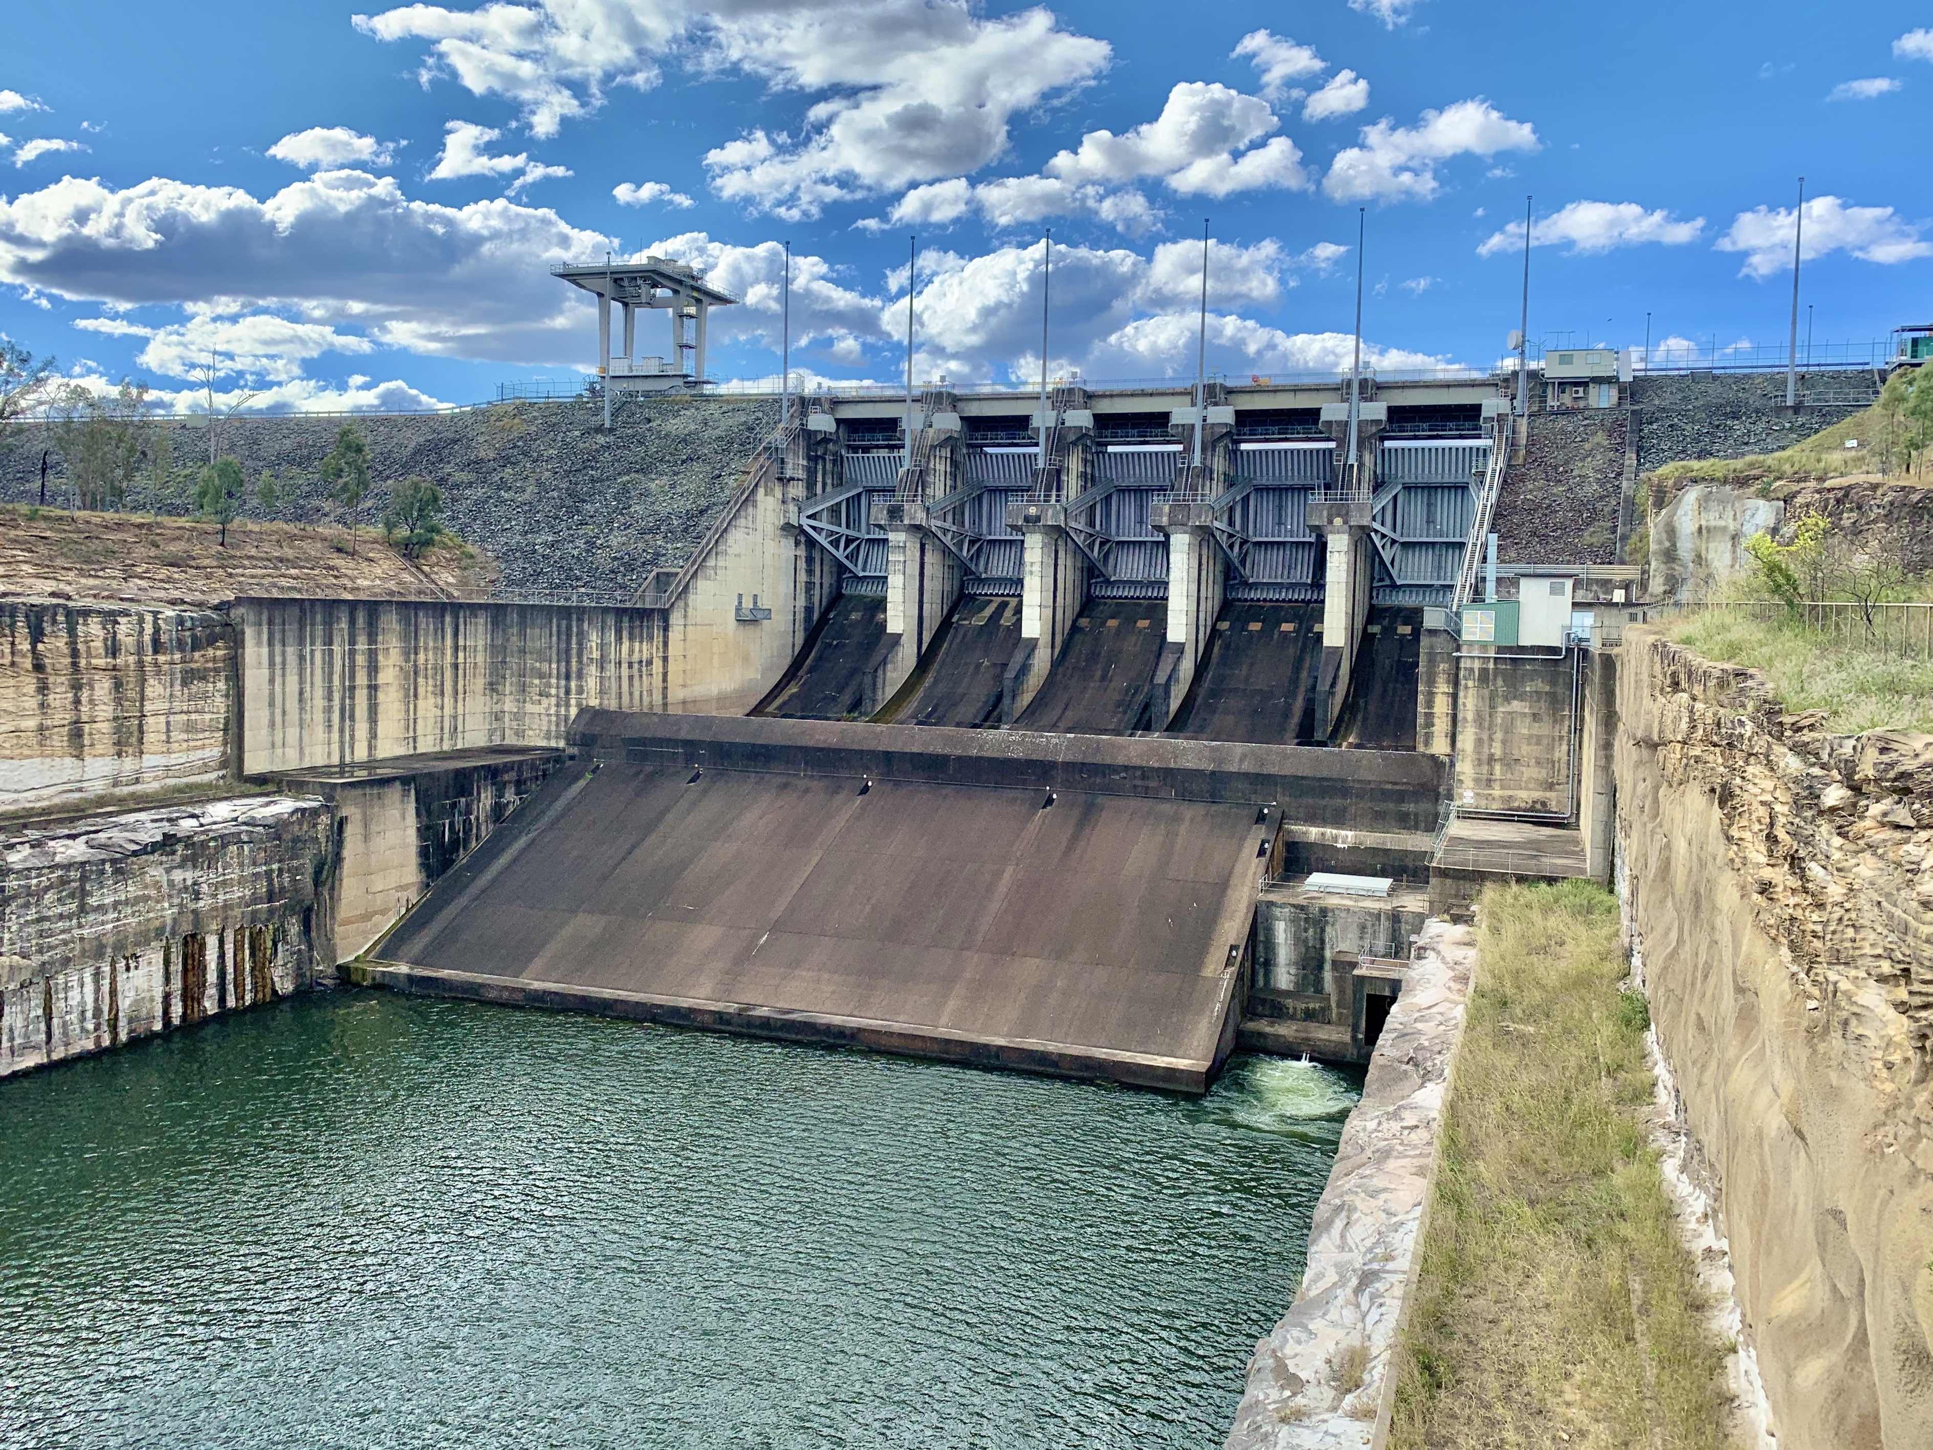
We only have one Planet
Resource Wars – Water
1. Sampa – https://commons.wikimedia.org/wiki/File:Baseline_water_stress.jpg – CC BY-SA 4.0.
2. Kgbo – https://commons.wikimedia.org/wiki/File:Closed_Wivenhoe_Dam_and_spillway,_August_2020.jpg – CC BY-SA 4.0.
3.Arian Zwegers – https://www.flickr.com/photos/azwegers/6226842732 – CC BY 2.0.

Slide 19
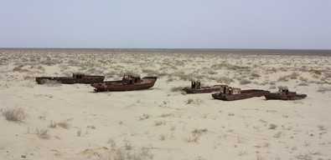
We only have one Planet
Resource Wars – Water
1. Sampa – https://commons.wikimedia.org/wiki/File:Baseline_water_stress.jpg – CC BY-SA 4.0.
2. Kgbo – https://commons.wikimedia.org/wiki/File:Closed_Wivenhoe_Dam_and_spillway,_August_2020.jpg – CC BY-SA 4.0.
3.Arian Zwegers – https://www.flickr.com/photos/azwegers/6226842732 – CC BY 2.0.

Slide 20
Environmental Pollution

Slide 21
Environmental Pollution
Definition
„Pollution, also called environmental pollution, the addition of any substance (solid, liquid, or gas) or any form of energy (such as heat, sound, or radioactivity) to the environment at a rate faster than it can be dispersed, diluted, decomposed, recycled, or stored in some harmless form.
The major kinds of pollution, usually classified by environment, are air pollution, water pollution, and land pollution.”
Nathanson, Jerry A.. "pollution". Encyclopedia Britannica, 22 Feb. 2022, https://www.britannica.com/science/pollution-environment. Accessed 11 April 2022.

Slide 22
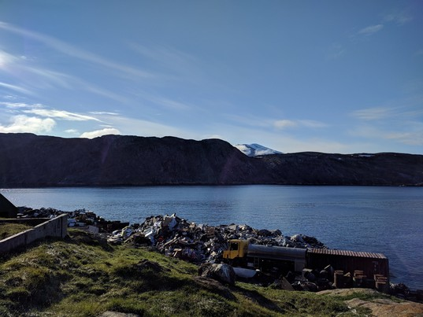
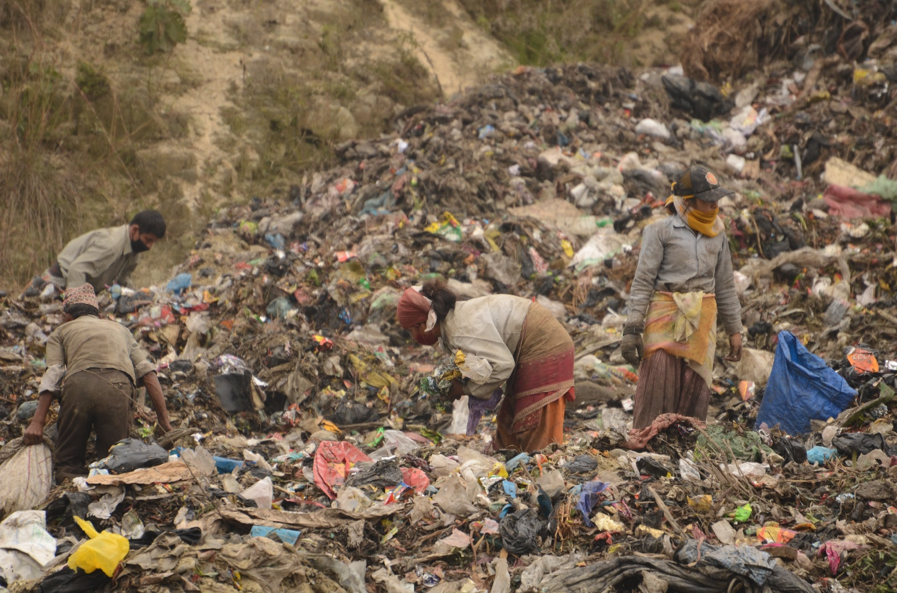
Environmental Pollution
Waste
1. "Landfill at Upernavik" by ulalume – https://www.flickr.com/photos/96649248@N00/43867280734 – CC BY-NC-ND 2.0.
2. Christian Hüpfer – https://flic.kr/p/aKXw2F – CC BY-SA 2.0.

Slide 23
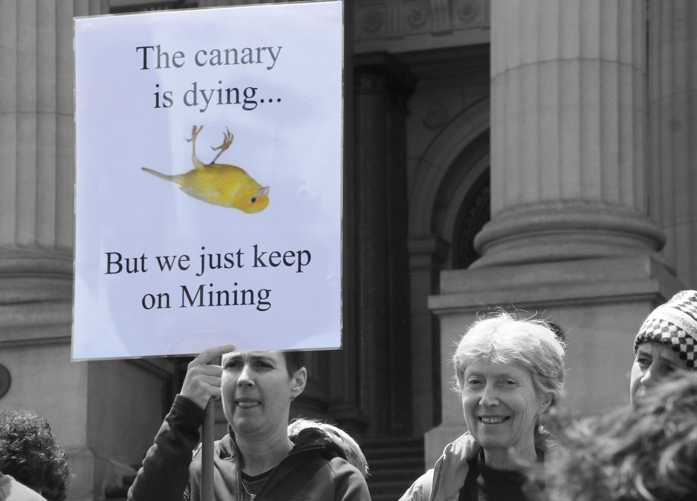
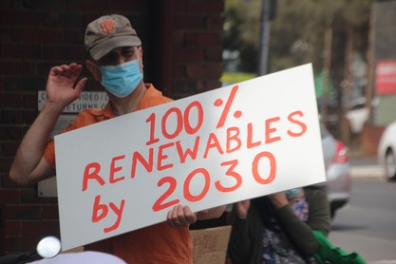
Environmental Pollution
Fossil Fuels
3 of the 10 dirtiest European coal plants are located in Poland
In which country/countries are the other 7 dirtiest coal plants located?
7 of the 10 dirtiest European coal plants are located in GERMANY
1. https://ember-climate.org/insights/research/top-10-emitters-in-the-eu-ets-2021/
2. John Englart – https://www.flickr.com/photos/takver/11308053925/ – CC BY-SA 2.0.
3. John Englart – https://www.flickr.com/photos/takver/51658831095/ – CC BY-SA 2.0.

Slide 24
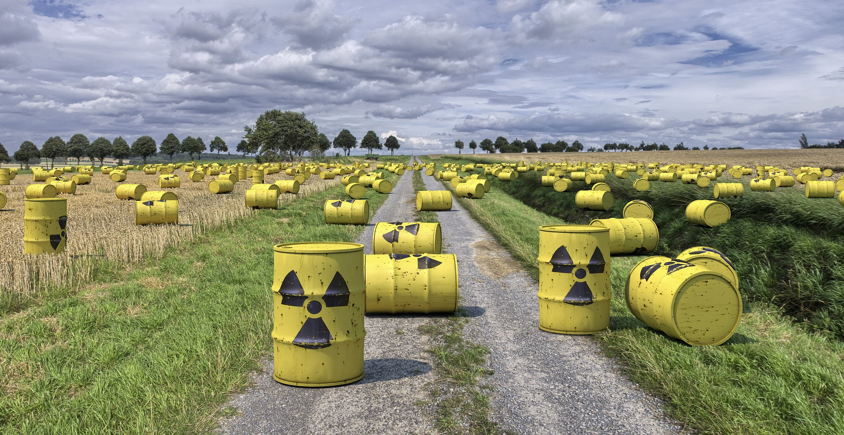
Environmental Pollution
Horrible Waste Management – Example 1

Slide 25
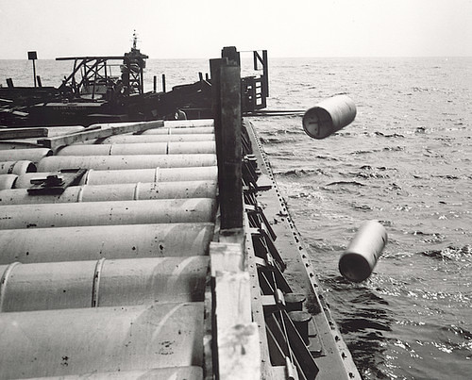
Environmental Pollution
Horrible Waste Management – Example 1
"Nuclear waste" by aaadrian365 is licensed with CC BY-NC 2.0. To view a copy of this license, visit https://creativecommons.org/licenses/by-nc/2.0/

Slide 26
Environmental Pollution
Horrible Waste Management – Example 1
→ 40,000 generations will have to live with the waste
→ 2 generations profited from cheap nuclear energy
https://www.spiegel.de/wissenschaft/technik/endlager-suche-was-wie-viel-und-wohin-damit-die-deutsche-atommuell-bilanz-a-7a153ba3-029a-4e55-adaf-3312b7427d9e

Slide 27
Environmental Pollution
Horrible Waste Management – Example 1
→ 40,000 generations will have to live with the waste
→ 2 generations profited from cheap nuclear energy
→ 40,000 generation will have to live with the waste
https://www.spiegel.de/wissenschaft/technik/endlager-suche-was-wie-viel-und-wohin-damit-die-deutsche-atommuell-bilanz-a-7a153ba3-029a-4e55-adaf-3312b7427d9e

Slide 28
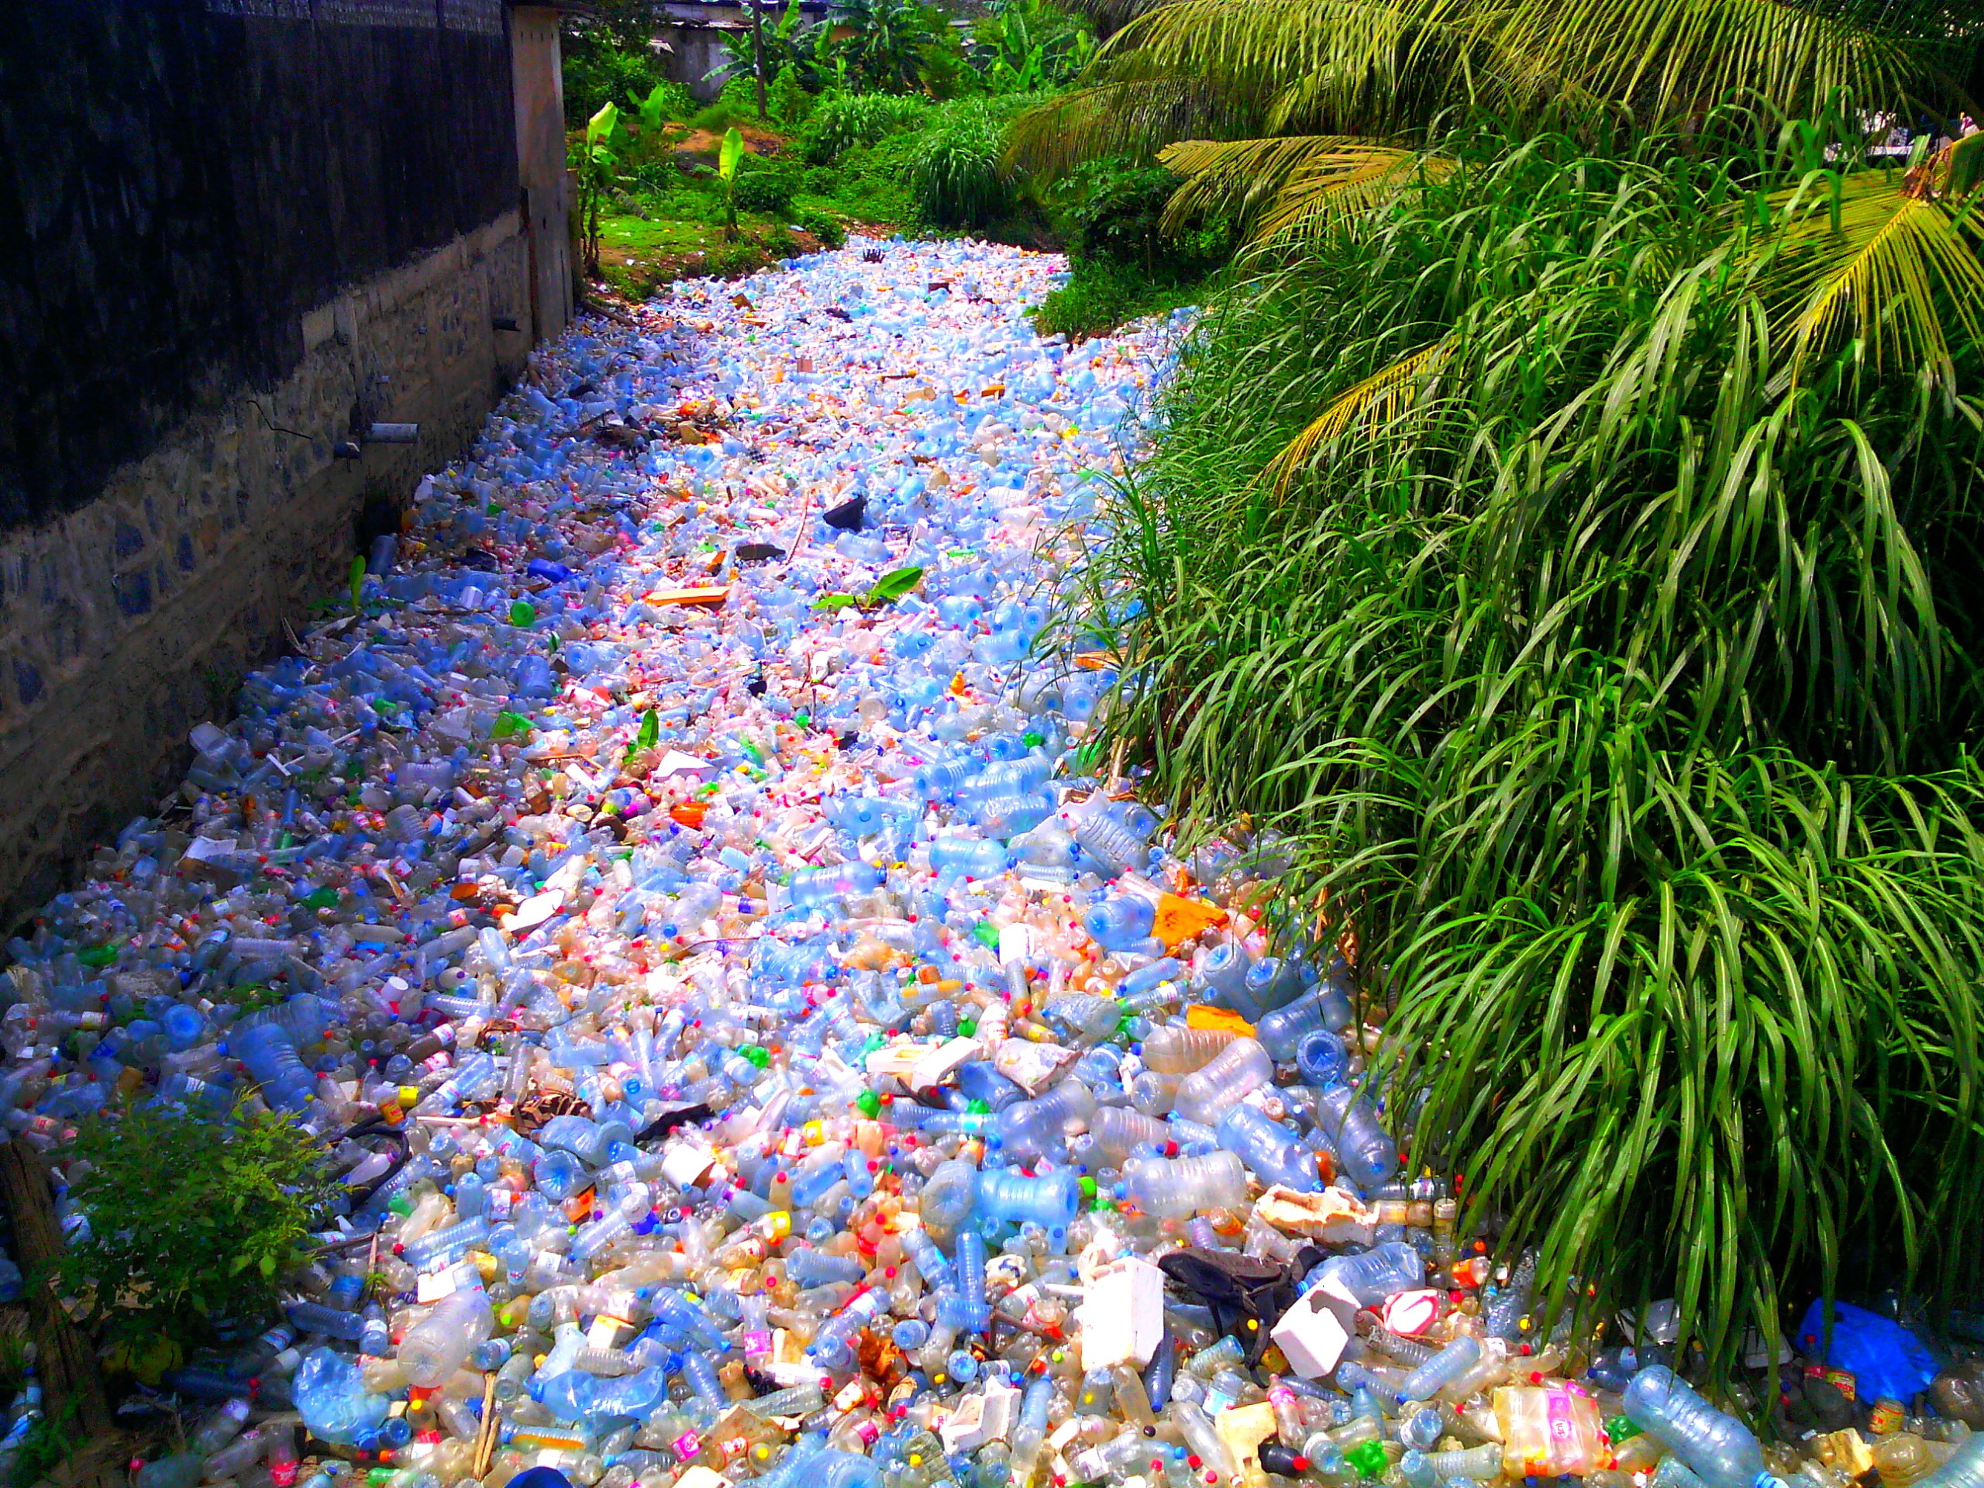
Environmental Pollution
Horrible Waste Management – Example 2
"Pollution Plastique" by Mouenthias is licensed with CC BY-SA 4.0. To view a copy of this license, visit https://creativecommons.org/licenses/by-sa/4.0/

Slide 29
Environmental Pollution
Horrible Waste Management – Example 2
We are consuming about 2000 tiny pieces of plastic every week.
That is a credit card every week!
That’s approximately 21 grams a month, or just over 250 grams a year.
"Pollution Plastique" by Mouenthias is licensed with CC BY-SA 4.0. To view a copy of this license, visit https://creativecommons.org/licenses/by-sa/4.0/
Wijnand de Wit and Nathan Bigaud for the WWF (2019) – No Plastic in Nature: Assessing Plastic Ingestion from Nature to People.

Slide 30
Environmental Pollution
Horrible Waste Management – Example 2
We are consuming about 2000 tiny pieces of plastic every week.
That is a credit card every week!
That’s approximately 21 grams a month, or just over 250 grams a year.
"Pollution Plastique" by Mouenthias is licensed with CC BY-SA 4.0. To view a copy of this license, visit https://creativecommons.org/licenses/by-sa/4.0/
Wijnand de Wit and Nathan Bigaud for the WWF (2019) – No Plastic in Nature: Assessing Plastic Ingestion from Nature to People.

Slide 31
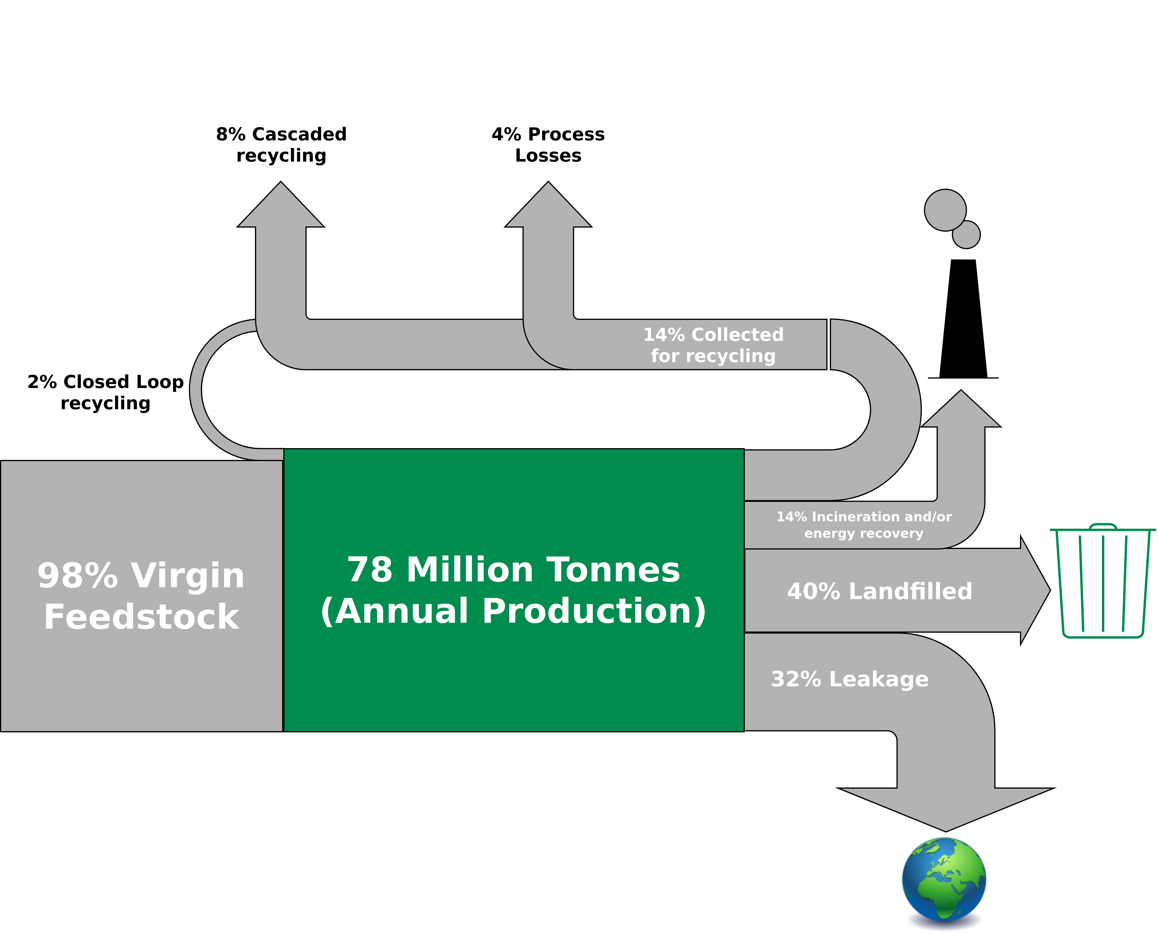
Environmental Pollution
Global Flows of Plastic Packaging Materials in 2013
Figure adapted from: Ellen MacArthur Foundation (2016) – THE NEW PLASTICS ECONOMY

Slide 32
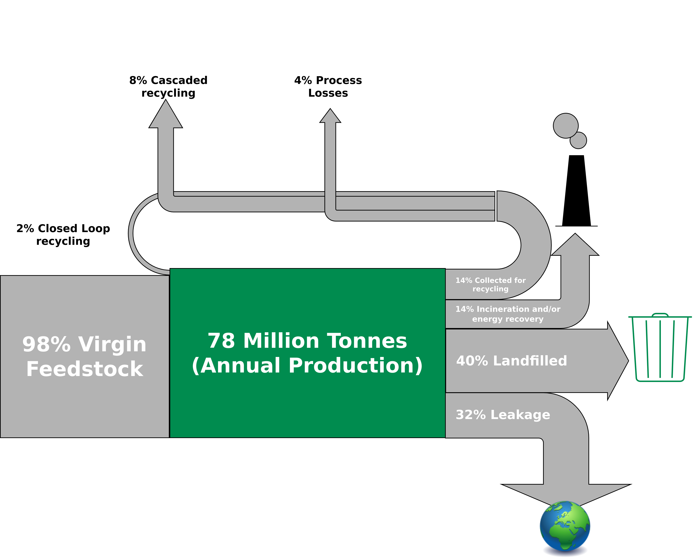
Environmental Pollution
Global Flows of Plastic Packaging Materials in 2013
In 2050, there will be more plastic than fish in the ocean (by weight) is a credit card every week!
That’s approximately 21 grams a month, or just over 250 grams a year.
Figure adapted from: Ellen MacArthur Foundation (2016) – THE NEW PLASTICS ECONOMY

Slide 33
Environmental Pollution
The Limits to Recycling
Recycling often requires a lot of energy
Some materials cannot be recycled at all (yet)
Impurities are challenging
Often requires a lot of manual labor
Recycled material often with lower quality than input material
False sense of safety!
I am not saying you should stop recycling!
→ Recycling is great but it is better to make sure that we do not have to recycle anything.
→ Buying less (only the essentials) is way more effective than recycling.

Slide 34
Environmental Pollution
The Limits to Recycling
Recycling often requires a lot of energy
Some materials cannot be recycled at all (yet)
Impurities are challenging
Often requires a lot of manual labor
Recycled material often with lower quality than input material
False sense of safety!
I am not saying you should stop recycling!
→ Recycling is great but it is better to make sure that we do not have to recycle anything.
→ Buying less (only the essentials) is way more effective than recycling.

Slide 35
Environmental Pollution
The Limits to Recycling
Recycling often requires a lot of energy
Some materials cannot be recycled at all (yet)
Impurities are challenging
Often requires a lot of manual labor
Recycled material often with lower quality than input material
False sense of safety!
I am not saying you should stop recycling!
→ Recycling is great but it is better to make sure that we do not have to recycle anything.
→ Buying less (e.g., only the essentials) is way more effective.
“We buy things we don't need, to impress people we don't like.” - Tyler Durden / Chuck Palahniuk

Slide 36
Conclusion

Slide 37
Conclusion
Basic concepts and definitions of sustainability and related to sustainability, resources, environmental pollution
The limits to recycling

Slide 38
Additional Resources
Baccini et al. (2012) – Metabolism of the Anthroposphere: Analysis, Evaluation, Design
Podcast How to Save a Planet – “Sacrifice Zones: ProPublica Takes Us Inside America’s Toxic Hotspots (2022) – Link

Slide 39
Questions?

